Slide 1
Automating Template Creation
with Packer, Source Control and CI/CD Pipelines
http://bit.ly/VMUG-Automating-Templates

Slide 2
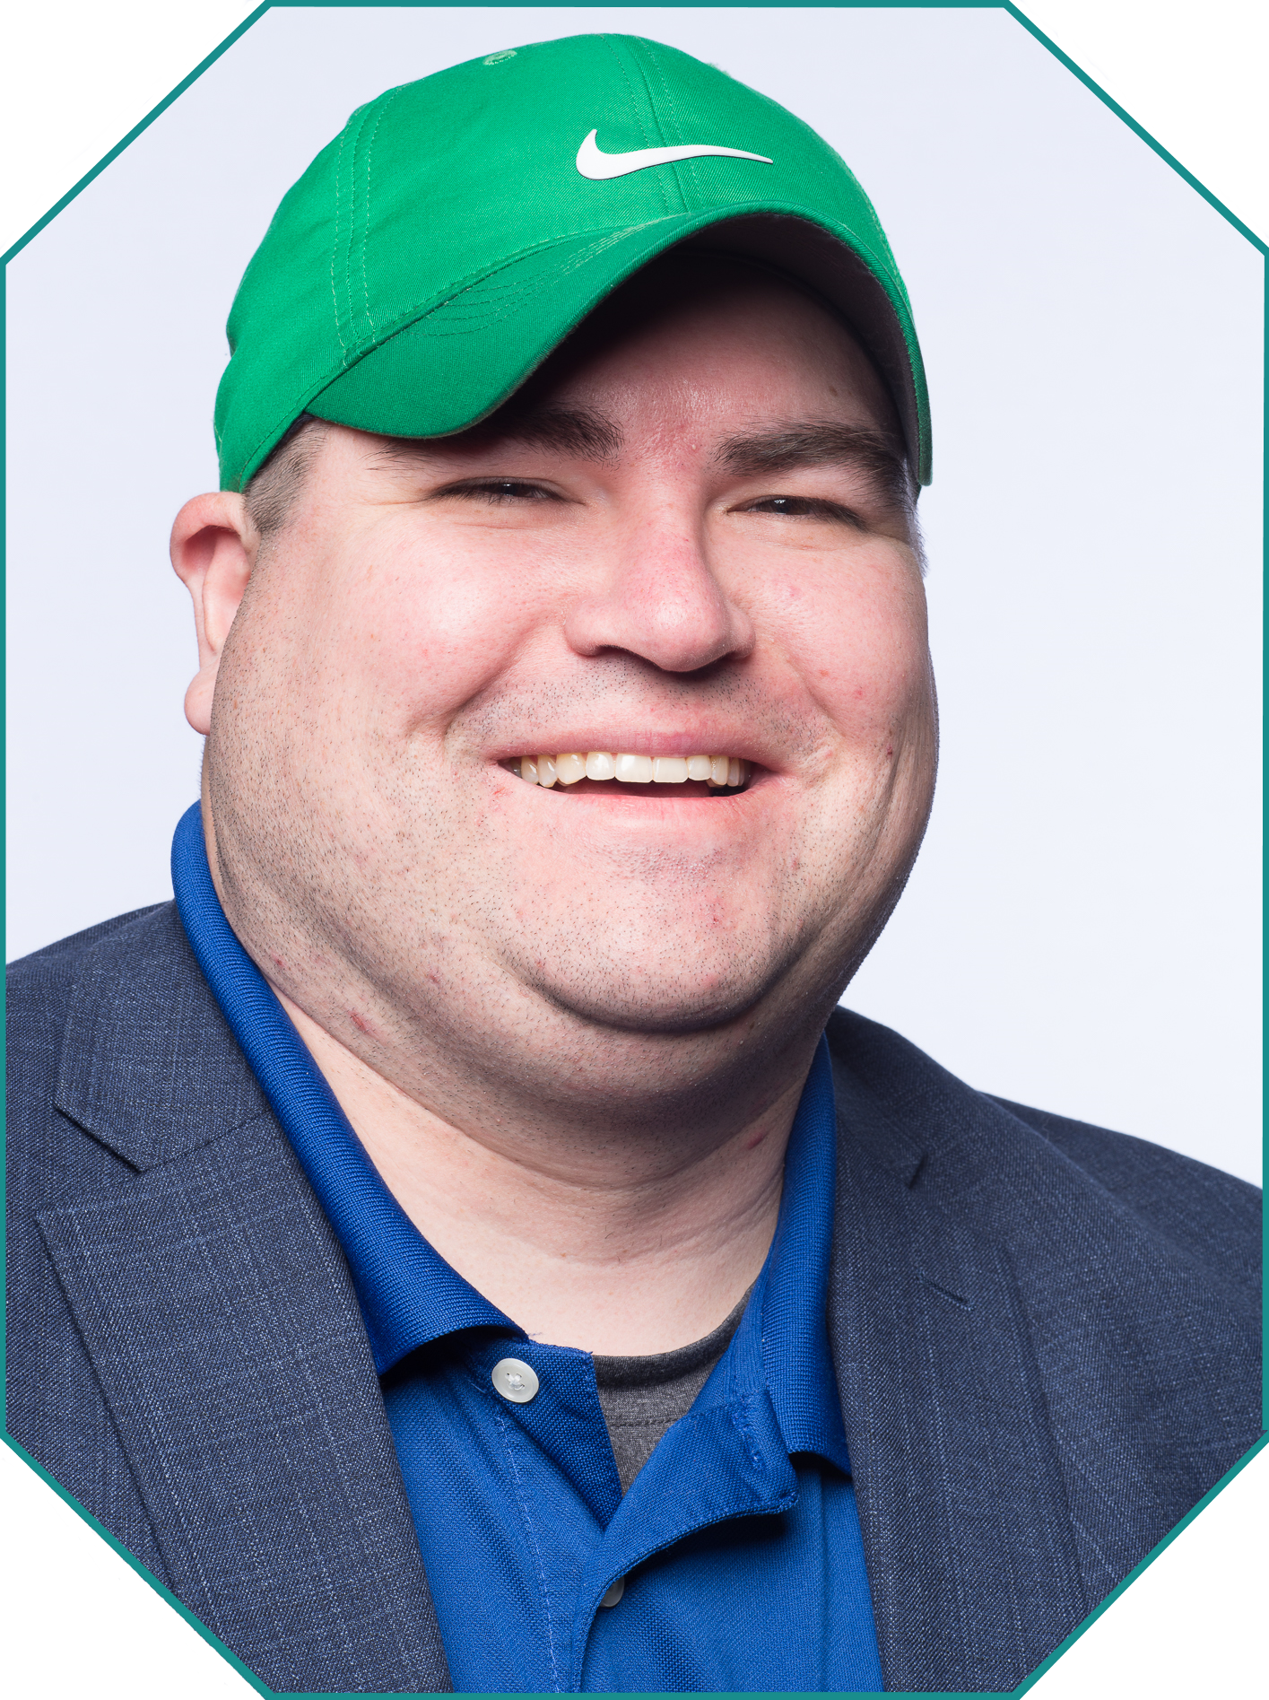
Howdy!
I’m Joe Houghes
I am here because I am a VMUG leader & I love to get people engaged and learning.
You can find me at @jhoughes or fullstackgeek.net
http://bit.ly/VMUG-Automating-Templates

Slide 3
Expectations
Quick run through
Basic concepts
Explanations, not expertise
Notes:
We’ll start here to understand what we’re getting into, especially for vSphere admins
Let’s level set some explanations, this is going to be basic concepts and discussing some things from a new perspective, so hopefully we will understand better
Will this session make anyone an expert… absolutely not, but it should help you to think about things a bit differently and see some basics in action, and will give you another step in your learning journey

Slide 4
What are we trying to accomplish?
What if we don’t do DevOps or CI/CD?
What do we get?
Do I need to do this?
What’s the point?
Notes:
This is still applicable if you’re not a DevOps focused shop, or you have no CI/CD pipeline currently. We’re taking something simple (and menial), and we’re just making it more automated
DevOps works to create certain, specific outcomes, and it’s only useful when you want those outcomes
Nope, if you don’t like what this process will bring to you, then don’t do it. But you may still get some benefit from understanding the tooling and how the components work.
Really think about how you make changes to your environment, test those changes to your environment, and being able to “undo’ change to your environment
This is all about enabling the rapid deployment of software. When that software breaks, DevOps is meant to equally support a rapid deployment of a replacement version, or of the last-known-good version
Even if you’re not going to fully automate software and infrastructure deployment pipelines, you should be aware of what the capabilities are when it comes to automating your environments

Slide 5
Start with a Plan

Slide 6


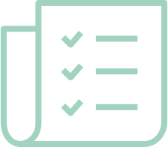

Define Success at the beginning
Define a Goal - Tasks & measurable results
Speed & performance = advantage, not benefit
Standardization, validation, efficiencies
Small, incremental changes = can be verified (MVP)
Notes:
Head’s up, here’s my usual speech to user groups, since it’s not just relevant for code:
This is the same whether you are using the GUI or CLI. Plan for success, ALWAYS.
Expect difficulties or failures, and be prepared to adjust your plan, but still plan for success. As part of your plan, define it well and be explicit with facts, assumptions and minimum requirements.
Speed and performance are great, but they are an advantage to the org, not the true benefit of automation.
Think about the real benefit to the business, which is accuracy & repeatability. It’s not about impressing someone with your code. It’s not just about doing it fast but doing it correctly and being certain that it stays that way.
The goal of these efforts isn’t just about getting your operations into code, it is the benefits that you can gain from it: standardization, granular control, validation of configs, and testing for success.
We need to build & maintain tools in this fashion, and now our tools are mirroring our internal environment and operations.
This makes it easier to improve or even re-write even as we change platforms or technologies, which is what really matters to them in the long-term.
Try to be specific about steps/components and have an expectation before you start.
Don’t do more than is necessary to make minor changes, so that you can track those changes and results.
Then, make additional changes as necessary, but test and verify them along the way.
If we understand these concepts and work with our organizations to help them operate in this fashion, it enables us to be more valuable to the organization as enablers of the business, and they can more easily trust our capabilities.
Don't fear the changes as your company's needs grow, and we can have the ability to continue to provide value to the business, which leads to great things in your career.

Slide 7
The Tools

Slide 8
Stackstorm
Robust open-source automation engine
“If This, Then That” – easy logic
Event-driven automation
Sensors, triggers, actions, rules
Workflows, packs
Audits
Notes:
structured configuration languages that are both human- and machine-friendly

Slide 9
Packer
Open-source Infrastructure as Code (IaC) tool
Building of automated machine images
Hashicorp Configuration Language (HCL2)
Multiple platform builds from config
Variable files – automatic & defined
Notes:
structured configuration languages that are both human- and machine-friendly

Slide 10
Terraform
Open-source Infrastructure as Code (IaC) tool
Consistent CLI workflow
Hashicorp Configuration Language (HCL2)
Declarative config files
Providers for resource dependencies
State files – resource map
Notes:
structured configuration languages that are both human- and machine-friendly

Slide 11
Demo Time

Slide 12
Thanks!
More Resources
http://bit.ly/ VMUG-Automating-Templates
Any questions?
You can find me at @jhoughes & joe@fullstackgeek.net

